Slide 1
Simulation and Limitation Analysis of Modern Delay-Tolerant Email
Deng Pan
24358871
CS7NS1(Future Networked Systems)
Notes:
Hello professors, I’m here to introduce my final-year project, which is called “Simulation and Limitation Analysis of Modern Delay-Tolerant Email.” The key words here are “Email” and “Delay.” First, I’d like to start by introducing the first keyword—Email.

Slide 2
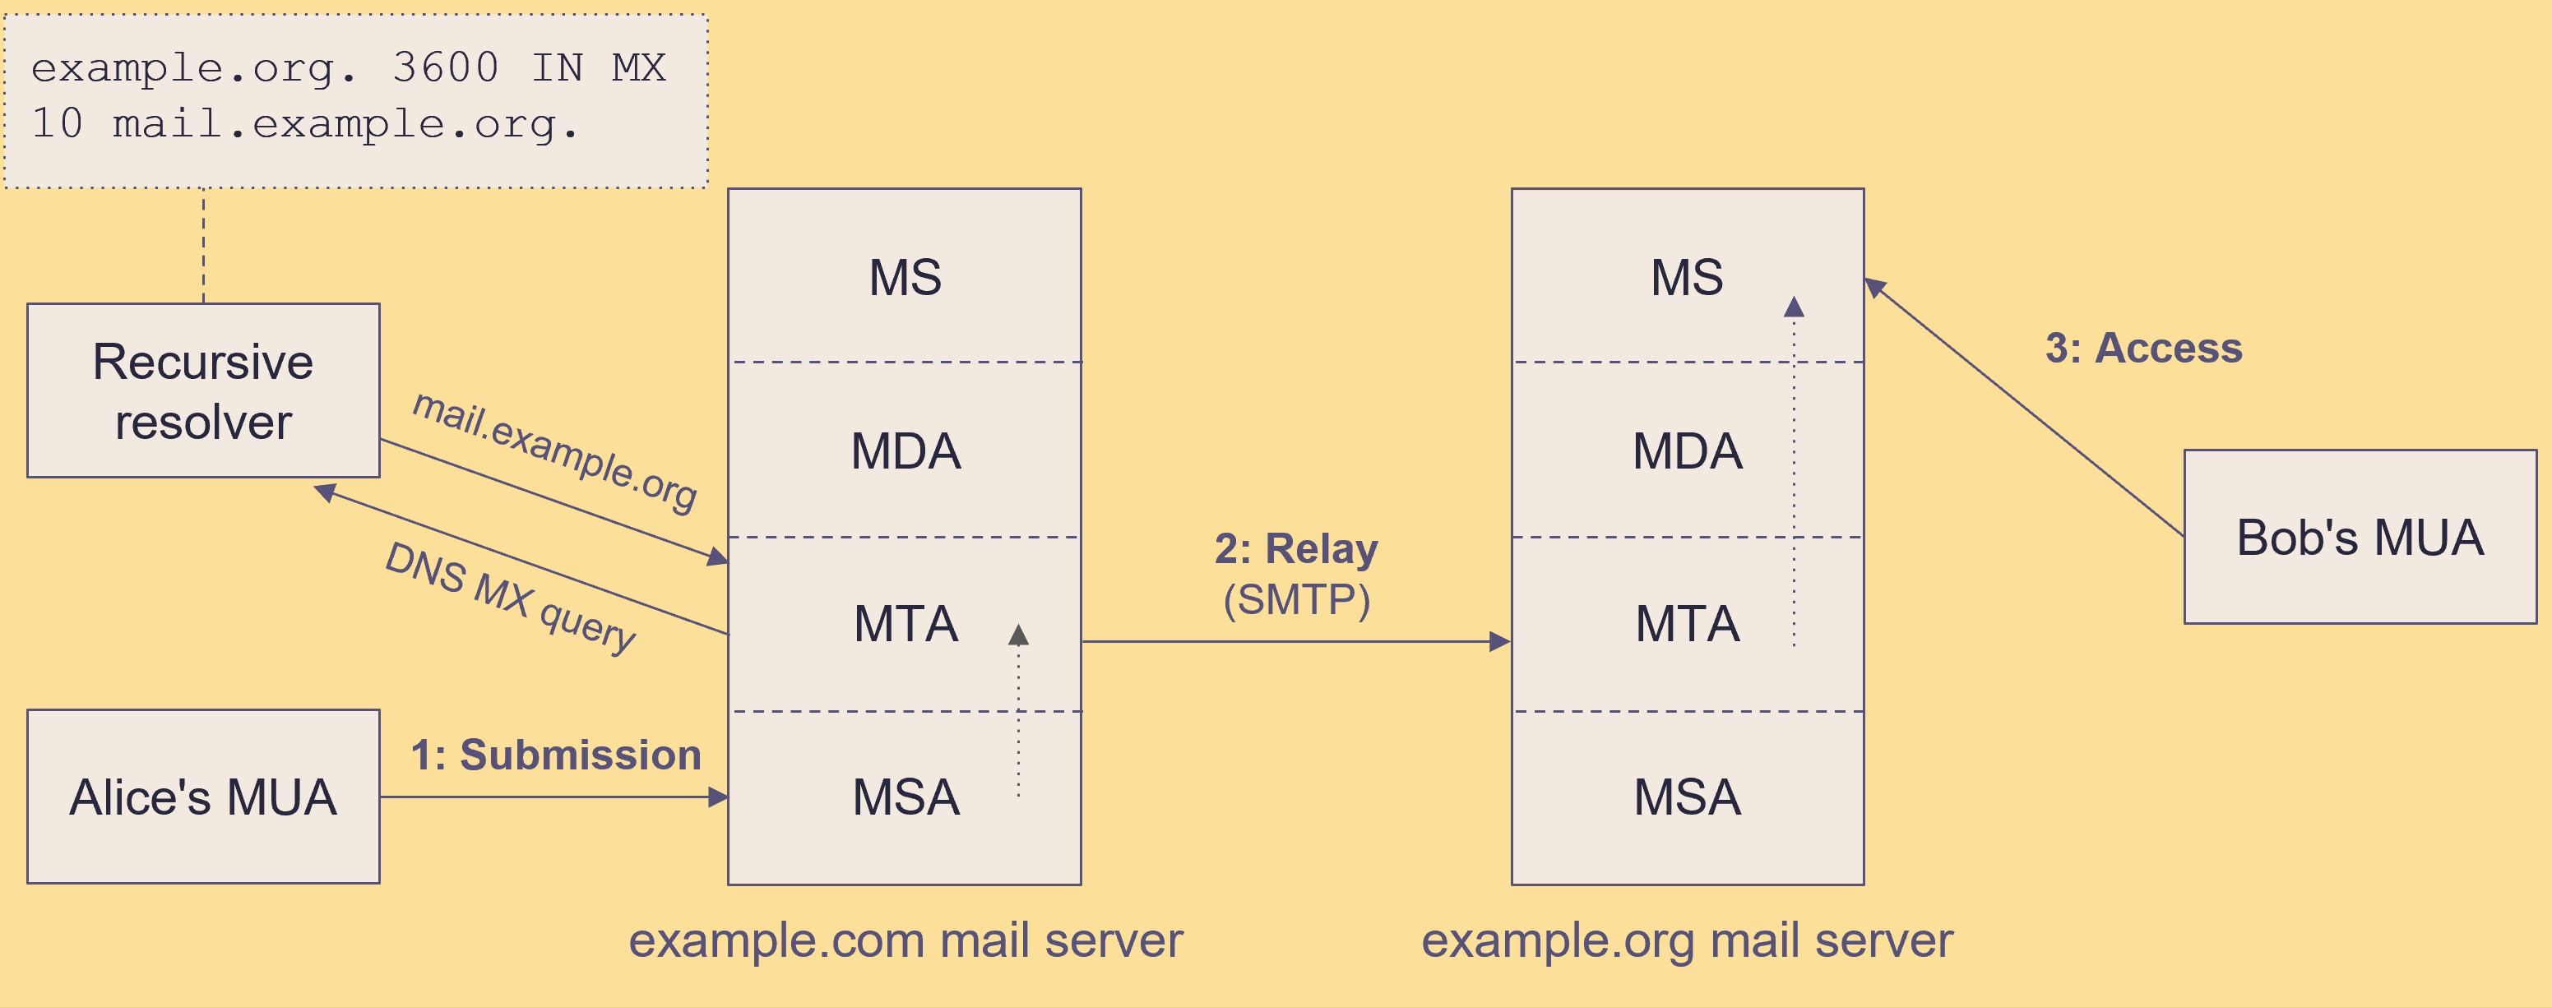





Email system
Client → Mail Server → Mail Server → Client
Thunderbird
Postfix
Thunderbird
Notes:
How does the email system work? Let me give you an example.
Suppose Alice wants to send an email to Bob. First, Alice opens the Thunderbird app on her smartphone to write the message.
After Alice finishes and clicks send, the email goes from her smartphone to a Mail Server. The Mail Server actually runs two programs. Postfix and Dovecot. Postfix works like a post office that receives the email. Then Postfix looks up the address of Bob’s mail server using DNS.
Example.org is also a Mail Server, and it runs its own Postfix program, which is like Bob’s local post office. Once the email reaches there, Postfix hands it over to Dovecot. Dovecot works like a mailbox.
Finally, when Bob opens Thunderbird and connects to Dovecot, he can read the email.

Slide 3
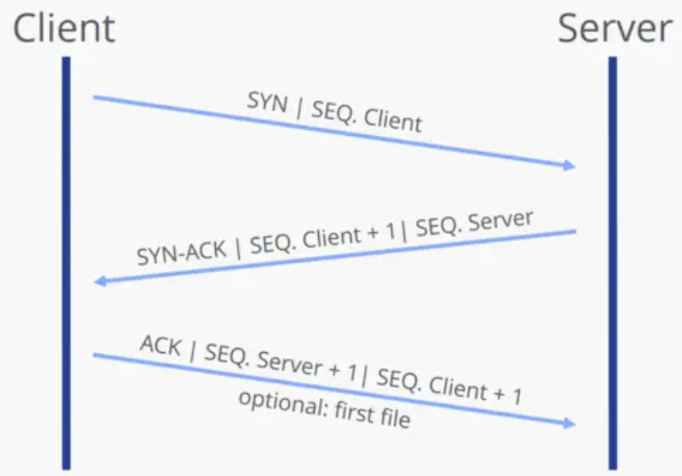

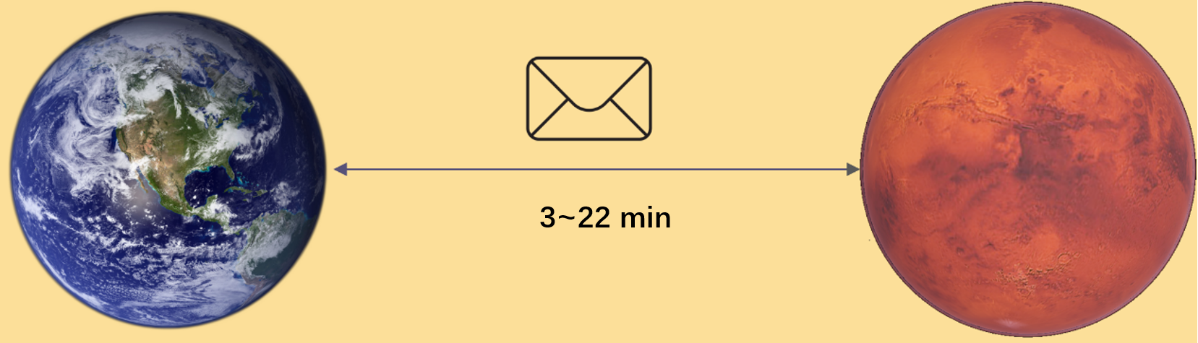
Space network
Two planets are very far from each other.
TCP three-way handshake
Features: high delays and frequent disruptions.
Notes:
Now let’s move on to the second keyword: delay. When we want to use the Internet in space, we run into a problem—two planets are very far from each other. For example, it takes light about 3 to 22 minutes to travel from Earth to Mars. Because of this, space networks have two main features that are very different from networks on Earth: high delays and frequent disruptions. Obviously, the TCP protocol, which needs multiple handshakes to set up a connection, doesn’t work anymore in this situation.

Slide 4
Delay-Tolerant Networking
The idea of DTN is “store and forward.” This means that when the network is disconnected, data packets are stored at each node instead of being thrown away. Once the connection is back, the node will keep forwarding the packets to their destination.
Notes:
To solve this problem, a new network architecture was designed. It is called Delay-Tolerant Networking. The idea of DTN is “store and forward.” This means that when the network is disconnected, data packets are stored at each node instead of being thrown away. Once the connection is back, the node will keep forwarding the packets to their destination.

Slide 5
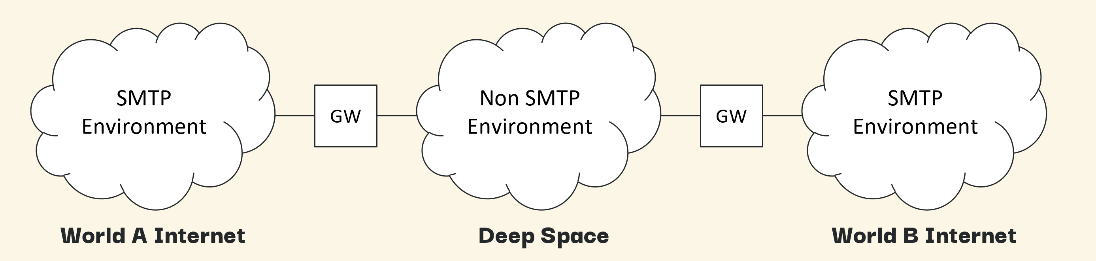
Email system with DTN
draft-johnson-dtn-interplanetary-smtp
In Johnson’s draft, he suggests that every planet has its own TCP/IP network, and DTN is used to connect the different planets together. The DTN and the TCP/IP network on each planet are joined using gateways.
Notes:
DTN solves the problems of space network, but there’s still one more challenge if we want to send interplanetary emails. Modern email uses the SMTP protocol, which is based on TCP/IP networks and doesn’t work well with DTN. So, Johnson came up with a solution——gateways. In Johnson’s draft, he suggests that every planet has its own TCP/IP network, and DTN is used to connect the different planets together. The DTN and the TCP/IP network on each planet are joined using gateways.

Slide 6
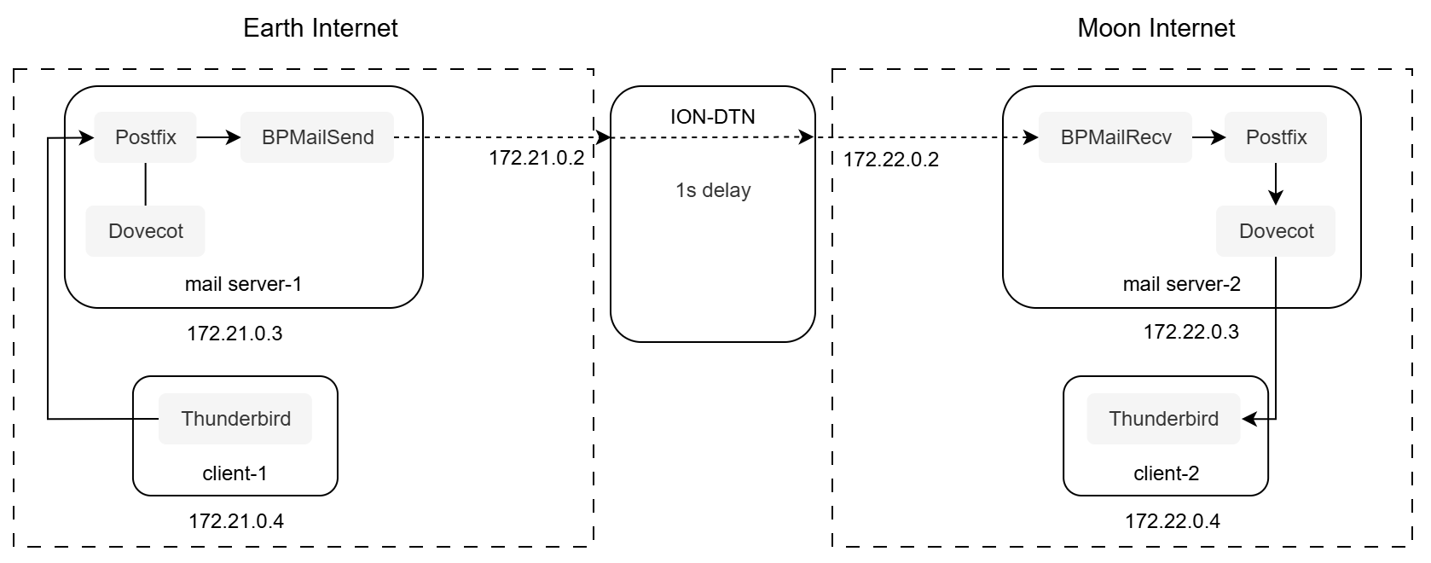

Simulation of Johnson’s Solution
I use 5 Docker containers in total: 2 represent mail servers on different celestial bodies, 1 is a delay container to simulate the space network, and the last 2 are the client container for users.
I made the DNS process simpler by just using the hosts file.
Notes:
First, the email is sent from the Thunderbird client to the mail server. Postfix on the mail server gets the email and hands it over to the BPMailSend gateway app. Once the gateway gets the email, it packs it in batch SMTP format, then puts it into a bundle. This bundle is sent to the Moon through the ION-DTN. After a one-second delay, another gateway, BPMailRecv, on the Moon gets the bundle, unpacks the email, and forwards it to the Postfix mail server, which then delivers it to the user.

Slide 7
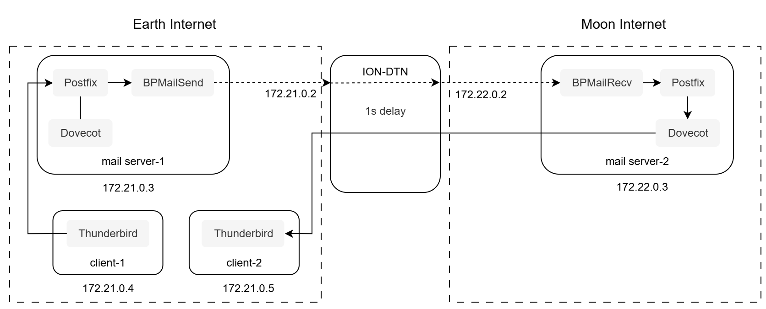
Extreme situation: What if users could travel between celestial bodies? How would they retrieve their email on a different celestial body?
Since this time the email retrieval doesn’t go through a gateway, DTN can’t help—the client has to connect directly to the mail server on the Moon using TCP over the space network. As a result, getting emails takes much longer than before.

Slide 8
I test different one-way network delays (0s/1s/2s/5s), and record the total time required to retrieve all emails (overall retrieval time).
The overall download time increases linearly with network delay. When the delay is 5 seconds, the email client becomes very sluggish and is almost unusable.
To improve the email retrieval experience in deep space, it is necessary to introduce a DTN retrieval agent or a batch synchronization mechanism during the email retrieval process.
Delay | Body | Number of emails | Overall retrieval time
0s | Hello | 1000 | 19s
1s | Hello | 1000 | 33s
2s | Hello | 1000 | 64s
5s | Hello | 1000 | 153s
Notes:
Brian Contreras

Slide 9
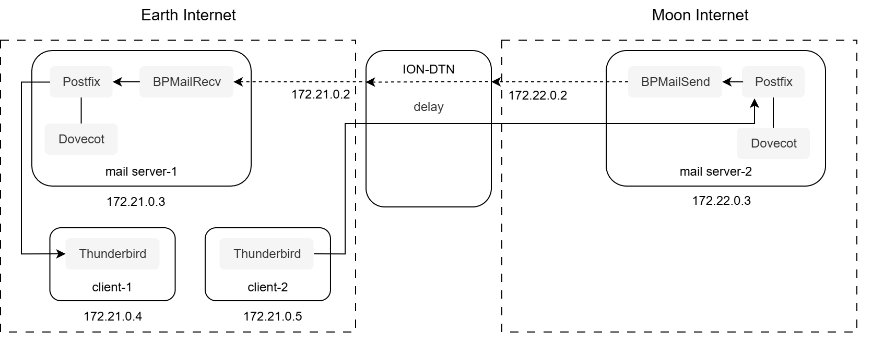
Besides receiving emails, sending emails also faces the same problems.
Notes:
Brian Contreras

Slide 10
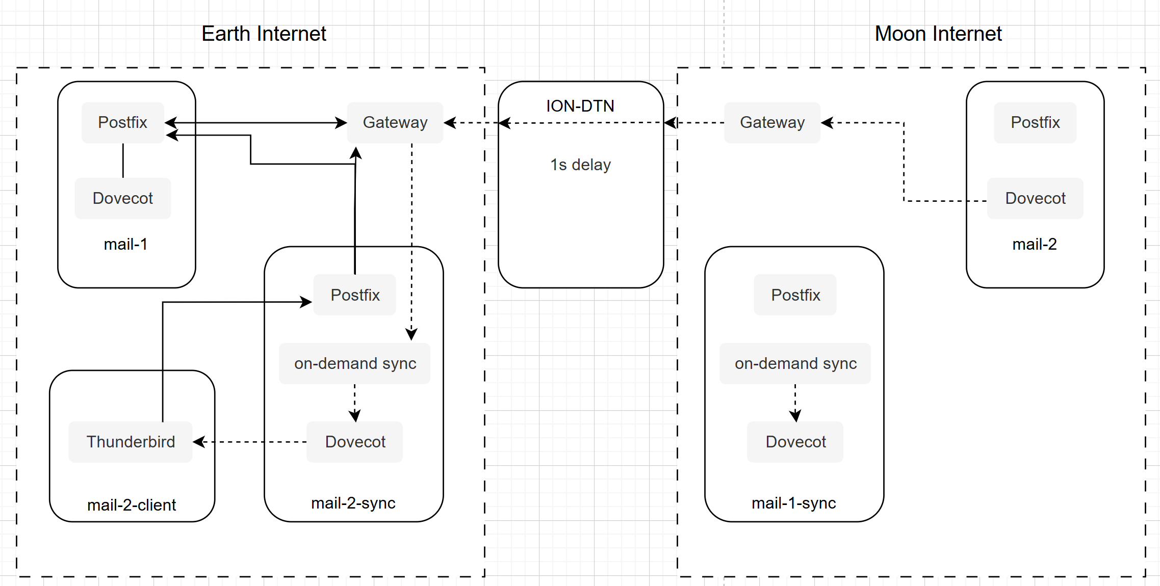
A possible solution
Set up another mail server for sending & synchronizing emails.
Notes:
I've got a simple idea for how to fix this. Let's just set up another mail server on every planet to handle sending and syncing emails. That way, all our interstellar communication would be sure to use DTN.

Slide 11
What I found
Johnson’s solution works well in mainstream scenarios, but it performs poorly in special cases—specifically, when users move between celestial bodies. If the delay is too high, this solution may not even be usable.
In addition, the Johnson solution does not explain how to implement email authentication technologies like Reverse DNS in an interplanetary network environment.
Notes:
From this simulation, I found that...

Slide 12
Conclusion
The gateway-based architecture make interplanetary email possible in simple scenarios. However, it cannot handle more complex situations. There are still many issues to solve before existing email systems can reliably send and receive emails across space.

